Slide 1
Talent Development
At HCL

Slide 2
Cucumber

Slide 3
Agenda
Introduction
Behavior Driven Development (BDD)
What is Cucumber
BDD Automation Test with Cucumber

Slide 4
Software Development Life Cycle
Requirement Gathering and Analysis
Design
Development
Testing
Deployment and Maintenance

Slide 5
Example of Requirement
Feature: login to the system.
As a user,
I want to login into the system when I provide username and password.
Scenario: login successfully
Given the login page is open
When I input username into the username textbox
And I input valid password into the password textbox
And I click Login button
Then I am on the Home page

Slide 6
Definition
Behavior-driven development (BDD) is an agile software development technique that encourages collaboration between developers, QA and non-technical or business participants in a software projects.
BDD
Business
Domain
Driven
design
Technology
Test Driven development

Slide 7
More Specific
It’s all about Given, When and Then – Maps easily to user stories
Extends Test Driven Development (TDD) by using natural language that non-technical stakeholder can understand.
Encourages collaboration between Domain experts, Business Analysts, QA Engineers, Developer and Business Owners/ Stakeholders.
Driven by Business Values and finally, with the aim of delivering “software that matters”.

Slide 8
BDD Scenario Details
A description of each specific case of the narrative. Such a scenario has the following structure:
Given The login page is opening
When I input correct username, password and click Login button
Then I am on Homepage
Given
When
Then
What software
will look like to user
Things that the user will do
What the user should expect

Slide 9
Mapping User Stories to BDD scenario
User Story | BDD Scenario
As a calculator user, I want to add two numbers so that I can do addition. | Given I have two numbers 500 & 500 When I add them up Then I should get result 1000
As a Math teacher, I want to automate marks sorting process so that I can declare top 5 in my class. | Given a list of numbers When I sort the list Then the list will be in numerical order
As a QA engineer, I want to check a critical feature so that I can do smoke test easily. | Given I visit Google.com When I type ‘HCL Technology' as a search string Then I should get search results matching HCL Technology

Slide 10
Cucumber Introduction
Cucumber is an open source Tool/ Framework/ Environment to practice Behavior Driver Development in Agile Project.
It runs automated tests written in a Behavior-Driven Development (BDD) style.
Cucumber API are written in Ruby, Java, C#, Python.
Cucumber used Gherkin syntax to implement BDD.
Cucumber plugins are available for Eclipse.
It can be integrated with web application automation tools like Selenium.
Provides integration with Maven and Jenkins.
Provides inbuilt test reporting in HTML and Junit format.

Slide 11
Cucumber Automation Steps
1. Describe Behavior
2. Write Step Definition
3. Run and Fail
4. Write code to make step pass
5. Run and Pass

Slide 12
Cucumber Approach
Project
Feature: login to the MYHCL account
As a user , I want to Login to system when I
provide username and password.
Scenario: Verify the user can login to MYHCL.
Features
Business Facing
Scenarios
Steps
Given I launch https://www.myhcl.com/Login/home.aspx
page
When I fill in my email id
“Sangram.swain@hcl.com”
And I fill in my password as “Passowrd@123”
And I set the domain as “HCLTECH”
And I click on “Login” button
Then I verify I am signed in
Step Definition
Support Code
Technical Facing
Automation Library
System

Slide 13
Example of BDD Scenario
Feature: login to the system.
As a user,
I want to login into the system when I provide username and password.
Scenario: login successfully
Given the login page is opening
When I input username into the username textbox
And I input valid password into the password textbox
And I click Login button
Then I am on the Home page

Slide 14
Cucumber with Selenium
Cucumber can be very efficiently used with Selenium Webdriver as a Test Framework for Functional, Regression and Cross-Browser testing.
It’s is FRIENDLY and UNDERSTANDABLE by non-technical User.
Automation framework based BDD Cucumber is NOT REALLY HARD to develop and maintenance.
Support on MULTIPLE PLATFORM,OS and different browsers
Cucumber serves the purpose of maintaining test scripts and test data as parameters in .feature files along with running test suites and test reporting while Selenium interacts with browser.
Cucumber interprets the tests into the specified programming language and uses Selenium to drive the test cases in a browser

Slide 15
Usage of Cucumber with Selenium
Web App Aut
Selenium WebDriver
Cucumber step definition
Cucumber Feature File with Test Script & Test Data
Test Results (HTML reports, screenshots, logs of failed scenarios)

Slide 16
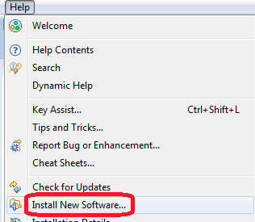
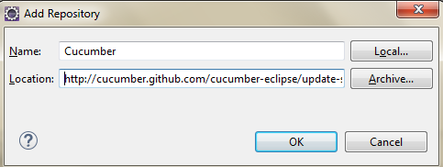
Cucumber Installation
TestNG -> Help -> Install New Software
Put the URL - http://cucumber.github.com/cucumber-eclipse/update-site
Click on Next.

Slide 17
Cucumber Automation Steps
Cucumber Feature File
1. Describe Behavior
2. Write Step Definition
3. Run and Fail
4. Write code to make step pass
5. Run and Pass
Cucumber Step Definition File
Real Code

Slide 18
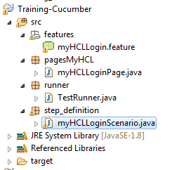
Cucumber Basic
A typical cucumber project looks like
Feature File
Automation Code
Test Runner to run code
Step Definition
Report Folder

Slide 19
Cucumber Basic
Feature File
For every cucumber project, there is a single directory at the root of the project with name “feature”.
This is where all the cucumber feature resides.
Feature file consists of
Feature: A feature would describe the current test script which has to be executed.
Scenario: Scenario describes the steps and expected outcome for a particular test case.
Scenario Outline: Same scenario can be executed for multiple sets of data using scenario outline. The data is provided by a tabular structure separated by (I I).
Given: It specifies the context of the text to be executed. By using data tables "Given", step can also be parameterized.
When: "When" specifies the test action that has to performed
Then: The expected outcome of the test can be represented by "Then"

Slide 20
Cucumber Basic
Feature File – Example
Feature: Login to www.myhcl.com webpage
Scenario: Successful login to MYHCL with valid user credentials
Given Browser should be launched and point to myHCL applications
When Enter valid user credentials
And Set domain as HCLTECH
And Click on Login button
Then User should be able to successfully login to the application

Slide 21
Cucumber Basic
Step Definition
Step definition maps the Test Case Steps in the feature files(introduced by Given/When/Then) to code.
It is the one which executes the steps on Application Under Test and checks the outcomes against expected results
For a step definition to be executed, it must match the given component in a feature

Slide 22
Cucumber Code
Download the code from - https://github.com/sangramkswain/HCLPuneTraining
File Name: ExtentReport.zip

